Slide 1

K2BSA
Radio
Merit Badge
2013 National Jamboree

Slide 2
Radio Merit Badge
K2BSA
Class Sessions
Session 1 – Radio basics, safety, and amateur radio
Session 2 – Amateur radio operating experience
Session 3 – Electromagnetic spectrum, components, careers, amateur radio licensing, and emergencies
2013 National Jamboree

Slide 3
Radio Merit Badge
K2BSA
Class Sessions
Session 1 – Radio basics, safety, and amateur radio
2013 National Jamboree

Slide 4
Radio
K2BSA
What is Radio
Radio is a way to electronically communicate from one place to another without wires
Radio is used in broadcasting, two way radios, television, mobile telephones, wireless LANs, garage door openers, car locks, EZpass, satellites, pagers, radar, microwave ovens, etc.
2013 National Jamboree
Radio M.B Req. 1

Slide 5
K2BSA
Broadcast Radio and
Hobby Radio
The differences between Broadcast & Hobby Radio
Broadcast radio sends information to many people at the same time.
  Examples: talk radio, music, or television.
Hobby Radio is used by amateur radio & citizens band operators and people that engage in activities where radio is helpful
  Examples: controlling models or tracking balloons or Family Radio Service (FRS) radios when camping
2013 National Jamboree
Radio M.B Req. 1a

Slide 6
K2BSA
Broadcast Radio and
Hobby Radio
Differences between Broadcasting & Two-Way Radio
Broadcasting is one-way communication from a transmitter to many receivers. It is usually planned programming and may be commercial with music, news, sports and advertising or non-commercial from schools, community radio stations, or National Public Radio (NPR).
Two-way radio uses both a transmitter and receiver at both ends. Examples are walkie-talkies, amateur radio, mobile telephones, fire and police, taxis, aviation, ships, military, etc.
2013 National Jamboree
Radio M.B Req. 1a

Slide 7
Radio Station Call Signs
K2BSA
Radio Call Signs
Call signs are a unique identification for a licensed radio station.
Broadcast radio station call signs are three or four letters.
  WABC, WLS, KNBC, KCMO
U.S. Amateur radio station call signs are letters and a number beginning with
W, K, A, or N.
  W1AW, K9BR, KB3BOY, WW9Y, N3YVH, K2BSA
Create Your Imaginary Call Sign
  Pick K, N, or W, a number, and add your initials
2013 National Jamboree
Radio M.B Req. 1.c.

Slide 8
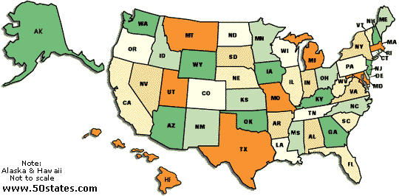
K2BSA
Radio Call Signs
K2BSA
PREFIX
NUMBER
SUFF
IX
K
PREFIX
W, K, N, A – USA F – France
VE, VO, XJ – Canada I – Italy
XE – Mexico 4X, 4Z – Israel
PY – Brazil JA – Japan
G – Great Britain ZL – New Zealand
KL7
2
1
2
ORIGINAL
CALL SIGN
DISTRICT
O
8
7
9
3
6
5
4
BSA
SUFFIX
KH6
2013 National Jamboree
Radio M.B Req. 1.c

Slide 9
K2BSA
Radio Call Signs
N1RY = “1 X 2”
NK8W = “2 X 1”
AE5BT = “2 X 2”
K2BSA = “1 X 3”
KD4MML = “2 X 3”
K7S = “1 X 1”
(SPECIAL EVENT STATION)
2013 National Jamboree
Radio M.B Req. 1.c

Slide 10
Phonetic Alphabet
K2BSA
Phonetic Alphabet
Many letters sound similar.
Over the radio, the letter C, E, V or Z might sound the same.
Weak radio signals and noise might make it difficult to hear voices.
An operator for whom English is not a native language may alter letter pronunciation.
Radio operators use a phonetic alphabet to improve understanding and avoid communication errors.
2013 National Jamboree
Radio M.B Req. 1.d.

Slide 11
Phonetic Alphabet
K2BSA
Phonetic Alphabet
Alfa (AL FAH)
Bravo (BRA VOH)
Charlie (CHAR LEE)
Delta (DELL TAH)
Echo (ECK OH)
Foxtrot (FOKS TROT)
Golf (GOLF)
Hotel (HOH TELL)
India (IN DEE AH)
Juliette (JEW LEE ETT)
Kilo (KEY LOH)
Lima (LEE MAH)
Mike (MIKE)
November (NO VEM BER)
Oscar (OSS CAH)
Papa (PAH PAH)
Quebec (KEH BECK)
Romeo (ROW ME OH)
Sierra (SEE AIR RAH)
Tango (TANG OH)
Uniform (YOU NEE FORM)
Victor (VIK TAH)
Whiskey (WISS KEY)
X-ray (ECKS RAY)
Yankee (YANG KEY)
Zulu (ZOO LOO)
2013 National Jamboree
Radio M.B Req. 1.d.

Slide 12
K2BSA
How Radio Waves Travel
Ionosphere
A
B
Around the World
Earth
Local
Earth
2013 National Jamboree
Radio M.B Req. 2.a.

Slide 13
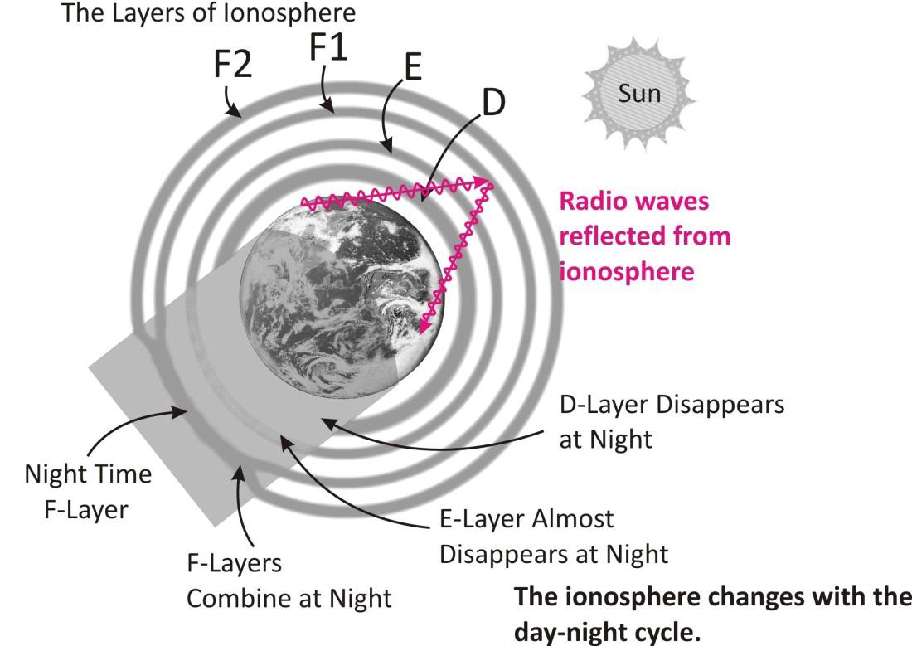
K2BSA
How Radio Waves Travel
Drawing from WØSTU
2013 National Jamboree
Radio M.B Req. 2.a.

Slide 14
How High Frequency (HF) Radio Waves Travel
K2BSA
How Radio Waves Travel
Ionosphere
Ground Wave (Local)
Sky Wave (DX)
Skip
Local
DX
Ionosphere
Earth
Skip
2013 National Jamboree
Radio M.B Req. 2.a.

Slide 15
WWV and WWVH
K2BSA
WWV and WWVH
National Bureau of Standard radio stations that provide accurate frequencies, time, and HF propagation forecasts.
WWV & WWVH transmit on 2.5, 5, 10, 15 and 20 MHz.
WWV is in Ft Collins, Colorado and WWVH is in Kauai, Hawaii.
Listening to WWV or WWVH provides an indication of the radio frequencies that are being reflected from the ionosphere and the locations from which you may hear radio stations for each frequency.
2013 National Jamboree
Radio M.B Req. 2.a.

Slide 16
K2BSA
WWV and WWVH
Sky waves skip around the world.
Ionosphere
WWV
Colorado
WWVH
Hawaii
SBR W.Va.
Earth
2013 National Jamboree
Radio M.B Req. 2.a.

Slide 17
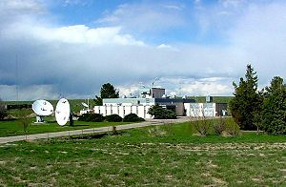
WWV in Ft. Collins, CO
K2BSA
WWV and WWVH
2013 National Jamboree
Radio M.B Req. 2.a.

Slide 18
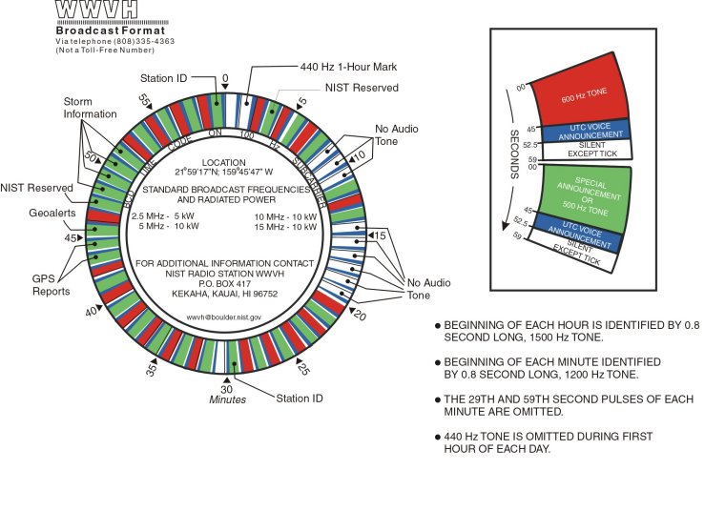
WWV and WWVH
K2BSA
WWV and WWVH
2013 National Jamboree
Radio M.B Req. 2.a.

Slide 19
DX and Local Stations
K2BSA
DX and Local
A DX station is a distant station usually located in another country.
  DX is the old Morse code abbreviation for distance. It refers to hearing or communicating with a radio station that is far away.
A local radio station is located in the nearby community or region.
2013 National Jamboree
Radio M.B Req. 2.b.

Slide 20
FCC – Federal Communications Commission
K2BSA
ITU and FCC
The FCC sets and enforces technical standards for devices that produce radio frequencies and issues licenses for radio stations, transmitters and operators.
The FCC does not have any authority outside of the United States.
2013 National Jamboree
Radio M.B Req. 2.b.

Slide 21
ITU – International Telecommunications Union
K2BSA
ITU and FCC
The ITU coordinates global telecommunications networks and services including management of radio frequency spectrum and satellite orbits.
The ITU tries to prevent harmful interference between radio stations but it depends upon cooperation among countries as it does not have the ability to enforce actions.
2013 National Jamboree
Radio M.B Req. 2.b.

Slide 22
K2BSA
Block Diagram vs Schematic
Oscillator
Amplifier
Simple Block Diagram
A block diagram shows a system as a
series of connected boxes.
+12 to 14
Pippin QRP TX
G3MY
VDC
R1
R2
68K
56
Q2
2N3905
Q1
2N2222A
>1 watt
C1
L1
L2
50 ohm
56pf
C5
XTAL
100nf
80m
R3
560
C2
C3
KEY
C4
RFC1
C6
C7
C8
50pf
150pf
0.1uf
22uh
Schematic Diagram
A schematic diagram of an electrical circuit is a drawing that shows how the circuit is built.
2013 National Jamboree
Radio M.B Req. 5a

Slide 23
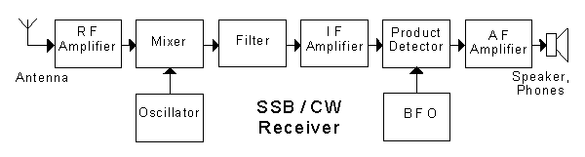
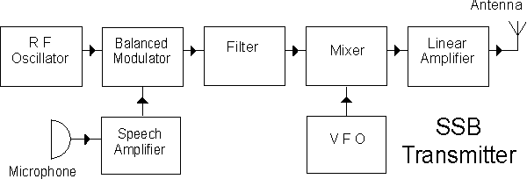
K2BSA
Detailed Block Diagrams
Shows more about how radios work
2013 National Jamboree
Radio M.B Req. 5.a.

Slide 24
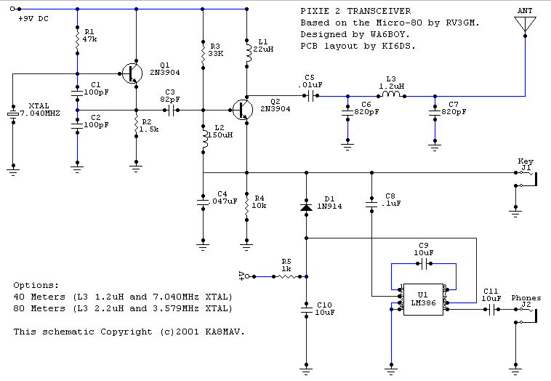
K2BSA
Detailed Schematic Diagram
Shows how to build a radio from components
2013 National Jamboree
Radio M.B Req. 5.a.

Slide 25
K2BSA
Block Diagrams
Draw a block diagram of a radio station:
ANTENNA
FEED
LINE
Speaker
TRANSCEIVER
AMPLIFIER
Microphone
National Jamboree
Radio M.B Req. 5 b

Slide 26
K2BSA
Block Diagrams
Draw a block diagram of a radio station:
ANTENNA
FEED
LINE
TRANSCEIVER
AMPLIFIER
Microphone
National Jamboree
Radio M.B Req. 5 b

Slide 27
Safety
K2BSA
Safety
National Jamboree
Radio M.B Req. 5 b

Slide 28
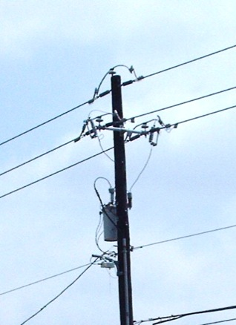
Electricity Safety
K2BSA
Electricity Safety
Electricity can kill you.
Minimum fatal voltage – 30 volts.
Minimum fatal current if passed through the human heart – 1/10th of an ampere.
Power lines are often suspended in the air and not insulated.
Power lines carry thousands of volts – never touch them.
2013 National Jamboree
Radio M.B Req. 6

Slide 29
Radio Safety Precautions
K2BSA
Radio Safety
Unplug equipment before working on it.
Never let anyone turn the power on and off for you.
Don’t work on a radio when you are tired.
Don’t use your bare hands to adjust components.
Don’t let your body be a ground path by touching grounded metal or standing in water.
Never wear headphones while working on a radio.
“Keep one hand in your pocket” so electricity can’t travel through your chest.
Tell your family how to turn off the power.
Be careful; death is permanent.
2013 National Jamboree
Radio M.B Req. 1.c.

Slide 30
Radio Frequency (RF) Energy
K2BSA
RF Energy
Exposure to high levels of radio frequency (RF) energy can be unhealthy. Direct contact can cause burns; human eyes are sensitive to RF energy.
Don't use a radio when it is not completely assembled as the cabinet shields the RF radiation.
Keep antennas out of reach.
2013 National Jamboree
Radio M.B Req. 1.c.

Slide 31
K2BSA
Grounding
Direct Current
Circuit Grounding
“Grounding” means establishing an electrical connection to an “electrically neutral” object that is at “0” Volts electric potential.
  A “ground” is often a long metal rod driven into the earth.
  Grounding is a safety measure to prevent electric shock and equipment damage.
Direct Current Circuits in radio equipment are grounded to prevent electric shock. The circuit is connected to the metal cabinet or “chassis” and the chassis is connected to a ground.
National Jamboree
Radio M.B Req. 6

Slide 32
K2BSA
Grounding
Power Outlet Grounding
Electric power enters a house through a box of circuit breakers. A metal ground rod is driven into the earth near where power enters the house to establish a Ground.
Power Outlets are connected to the circuit breaker box with three wire cable and one of the wires is connected to Ground.
Equipment is connected to Power Outlets with three prong plugs and one prong is connected to the Ground.
  The equipment case is then grounded to prevent electric shock.
National Jamboree
Radio M.B Req. 6

Slide 33
K2BSA
Grounding
Antenna System Grounding
Antenna systems often include tall towers or objects that might be struck by lightning.
Antenna systems include transmission lines connecting the antenna to radio equipment.
Lightning arrestors are devices inserted into transmission line with a spark gap or gaseous discharge to ground.
Antenna system grounding should include both a ground connection for the antenna tower and a lightning arrestor in the transmission line where it enters the house.
The lightning arrestor may discharge static electricity but likely offers little protection from a direct strike.
National Jamboree
Radio M.B Req. 6

Slide 34
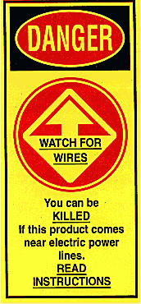
K2BSA
Antennas and Towers
Antennas and Towers
Never install an antenna over, under, or very near a power line.
Avoid the possibility of the antenna falling on the power line or the power line falling on the antenna.
National Jamboree
Radio M.B Req. 6

Slide 35
K2BSA
Antennas and Towers
Antennas and Towers
Never install an antenna where a person could touch the antenna.
Be careful working on towers and roofs.
  Protect yourself from falling.
  Protect people below you from falling objects.
  Use safety harnesses, belts, tethers, and hard-hats.
National Jamboree
Radio M.B Req. 6

Slide 36
K2BSA
Lightning Protection
Lightning Protection
Antenna support poles and towers should be connected to a ground rod.
Disconnect radios if lightning is in the area.
Lightning could strike your antenna and travel down the transmission line to the radio.
Make sure your antenna and radio are grounded to a good earth ground.
Never operate your radio in thunderstorms.
National Jamboree
Radio M.B Req. 6

Slide 37
Amateur Radio
K2BSA
Amateur Radio
National Jamboree

Slide 38
K2BSA
Amateur Radio Service
What is Amateur Radio?
A type of two-way radio. A place to learn about radio.
Called the “Amateur Radio Service” because it can’t be used for profit.
Also known as “Ham Radio”.
An important part of disaster response.
A lot of fun!
National Jamboree
Radio M.B Req. 9.a(1)

Slide 39
K2BSA
Amateur Radio Service
Why does the FCC have an
Amateur Radio Service?
Public service - community service and disaster help (A Scout does a good turn daily – here is another way).
International goodwill - A great way to talk to people in other countries.
Experimentation - Hams have made inventions like FM, SSB, Packet Radio, Automatic Position Reporting Systems.
Communication skills - Many people trained to communicate.
National Jamboree
Radio M.B Req. 9.a(1)

Slide 40
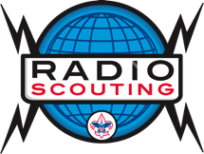
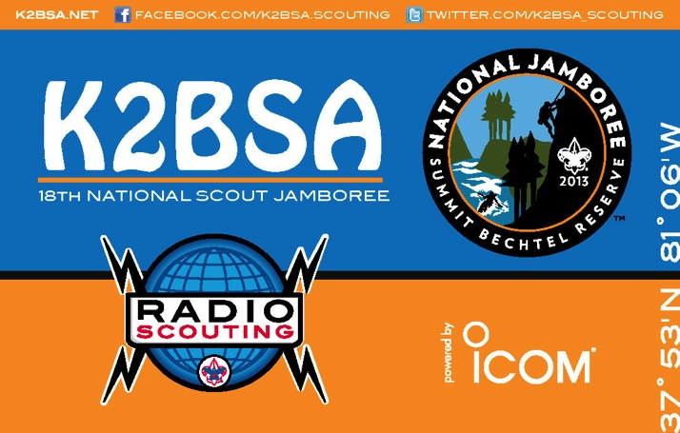
Amateur Radio Activities
K2BSA
Amateur Radio Service
Jamboree On The Air (JOTA)
  The third weekend every October.
  Scouts all over the world talk to each other on ham radio. Largest annual scouting event.
DX (Long Distance Communication)
  Talk to other hams around the world.
  Collect QSL cards (postcards) to prove
  contact (Collect countries!).
  Great way to have fun and learn geography.
Contests
  Held many weekends to contact as many people as possible from a certain place or in a certain way.
National Jamboree
Radio M.B Req. 9.a(1)

Slide 41
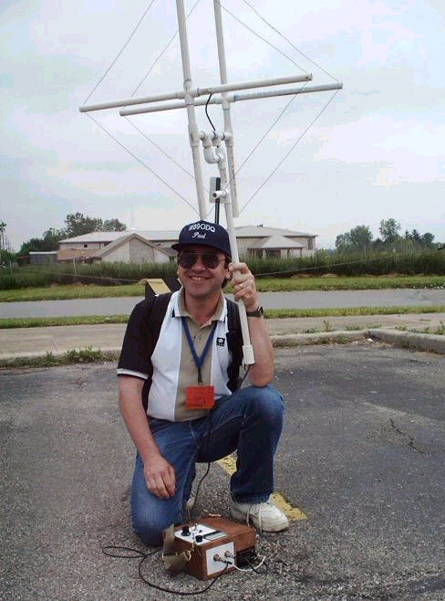
K2BSA
Amateur Radio Service
Amateur Radio Activities
Skywarn
  National Weather Service uses Hams to
  report severe weather
“Fox” hunting (Radio Direction Finding)
  Hidden transmitters
  Tagged wildlife
  Downed aircraft
  Life rafts
  Stolen cars
Packet radio
  Sending electronic messages (e-mail, text)
  via radio
National Jamboree
Radio M.B Req. 9.a(1)

Slide 42
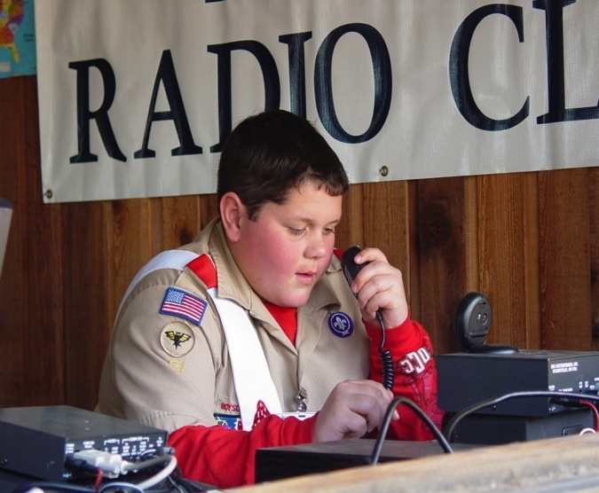
K2BSA
Amateur Radio Service
Amateur Radio Activities
Public Service.
  Parades & special events from small carnivals to the Rose Bowl Parade.
  Help with communication at large community events, marathons, bike-a-thons, etc.
National Jamboree
Radio M.B Req. 9.a(1)

Slide 43
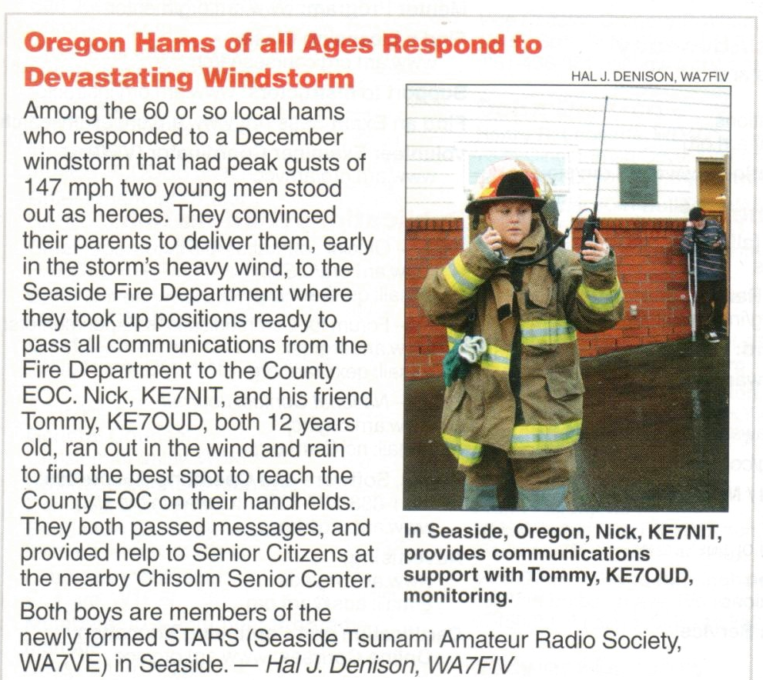
K2BSA
Amateur Radio Service
Amateur Radio Activities
Disaster
Communication
  Hams help during fires, floods, earthquakes, and other disasters.
  At these times, telephone lines and cell phone sites are often damaged or overloaded.
  Ham radio is the only reliable form of communication.
National Jamboree
Radio M.B Req. 9.a(1)

Slide 44
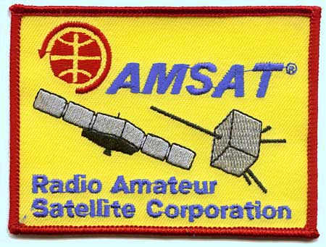
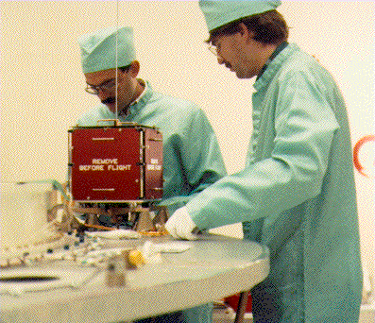
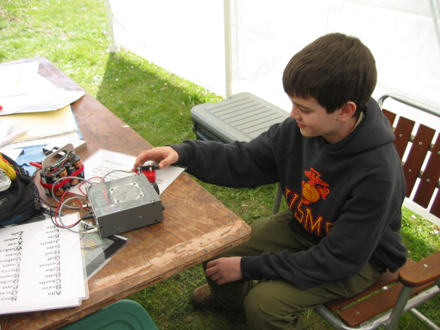
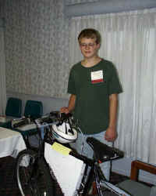
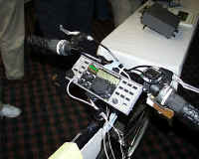
K2BSA
Amateur Activities
OSCAR
Morse Code
Foxhunting
Bicycle Station
National Jamboree
Radio M.B Req. 9a(1)

Slide 45
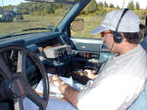
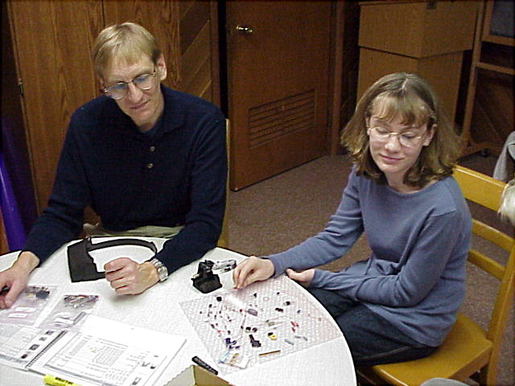
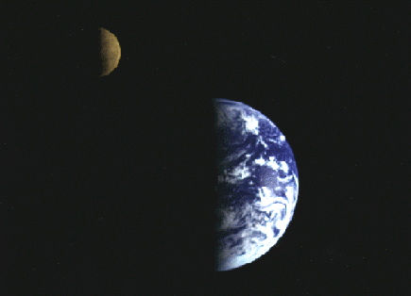
K2BSA
Amateur Activities
Mobile
Kit Building
Moonbounce
National Jamboree
Radio M.B Req. 9a(1)

Slide 46
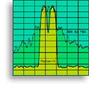
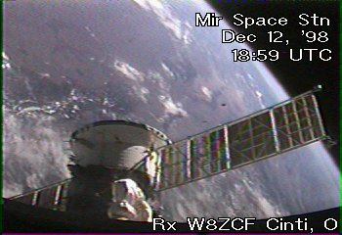
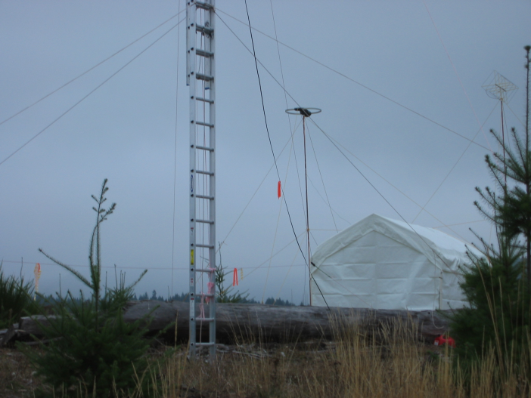

K2BSA
Amateur Activities
Digital Modes
Slow Scan TV image from MIR
Field Operating
Emergency
Communications
National Jamboree
Radio M.B Req. 9a(1)

Slide 47
K2BSA
Q Signals and Abbreviations
QRM | Interference (Your radio signal is being interfered with.)
QRN | Static (Your radio signal is being interfered with by static.)
QRP | Low power radio operation
QRS | Send your Morse code more slowly.
QRT | Leaving the air (I’m stopping my radio activity.)
QRX | Wait a few minutes.
QRZ? | Who is calling?
QSB | Your signals are fading.
QSL | A card sent to indicate you’ve talked to or heard a radio station; also, as a Q signal that means (Received OK)
QSO | A conversation.
QSY | I am moving to another radio frequency. . .
QTH | My location is. . .
73 | Best regards
RST | Readability, Strength, Tone (Signal report)
CQ | I am calling…
National Jamboree
Radio M.B Req. 9a(2)

Slide 48
Radio Merit Badge
K2BSA
Class Sessions
Session 2 – Amateur radio operating experience
2013 National Jamboree

Slide 49
Make a Ham Radio Contact
K2BSA
Radio Operations
Listen and call another ham radio station
Talk with the other Radio Station Operator.
  Relax and have fun
  Your name
  Where you live
  Describe your school
  Talk about Scout camp
Use Q-signals
Log your contact
2013 National Jamboree

Slide 50
Log Your Contact
K2BSA
Radio Operations
His Name ________________
His Call ________________
His QTH (location) ________________
Frequency ________________
Mode ________________
His RST (signal report) ________________
My RST (signal report) ________________
Comments ________________
2013 National Jamboree

Slide 51
Radio Merit Badge
K2BSA
Class Sessions
Session 3 – Electromagnetic spectrum, components, careers, amateur radio licensing, and emergencies
2013 National Jamboree

Slide 52
K2BSA
Q Signals and Abbreviations
QRM | Interference (Your radio signal is being interfered with.)
QRN | Static (Your radio signal is being interfered with by static.)
QRP | Low power radio operation
QRS | Send your Morse code more slowly.
QRT | Leaving the air (I’m stopping my radio activity.)
QRX | Wait a few minutes.
QRZ? | Who is calling?
QSB | Your signals are fading.
QSL | A card sent to indicate you’ve talked to or heard a radio station; also, as a Q signal that means (Received OK)
QSO | A conversation.
QSY | I am moving to another radio frequency. . .
QTH | My location is. . .
73 | Best regards
RST | Readability, Strength, Tone (Signal report)
CQ | I am calling…
National Jamboree
Radio M.B Req. 9a(2)

Slide 53
The Electromagnetic Spectrum
K2BSA
2013 National Jamboree

Slide 54
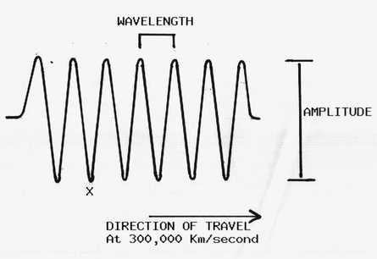
Radio Waves
K2BSA
Electromagnetic Spectrum
Electromagnetic energy
Travels at the speed of light
2013 National Jamboree
Radio M.B Req. 3.a.

Slide 55
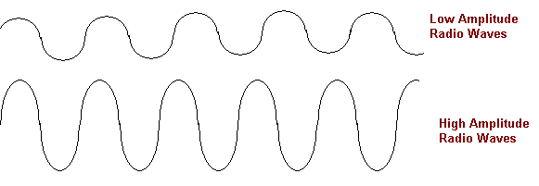
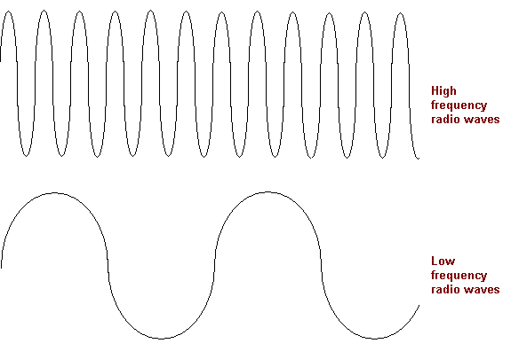
Radio Waves
K2BSA
Electromagnetic Spectrum
2013 National Jamboree
Radio M.B Req. 3.a.

Slide 56
Frequencies
(One Hertz is one cycle per second)
K2BSA
Electromagnetic Spectrum
Direct Current ………0 Hertz (goes in only one direction)
Alternating Current ..60 Hertz (Hz)
Audio (Sound)………100 Hz to 20 kHz (100-20,000 Hz)
LF…………………….30-300 kHz (30,000-300,000 Hz)
MF……………………0.3-3 MHz (300,000-3,000,000 Hz)
HF or Shortwave……3-30 MHz (3,000,000-30,000,000 Hz)
VHF ………………….30-300 MHz (30,000,000-300,000,000 Hz)
UHF………………….300-3,000 MHz (well, you get the idea)
Microwave…………..Frequencies above 500 MHz
Visible Light………...400-800 THz (400,000,000-800,000,000 MHz)
2013 National Jamboree
Radio M.B Req. 3.a.

Slide 57
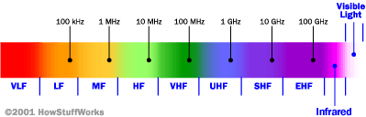
The Electromagnetic Spectrum
K2BSA
Electromagnetic Spectrum
Sound
Long Radio Wavelengths
Short Radio Wavelengths
Microwaves
Frequency - Measured in Hertz (kilohertz, megahertz, gigahertz)
Wavelength – Measured in meters (cm)
Inverse relationship between frequency and wavelength
2013 National Jamboree
Radio M.B Req. 3.a.
Notes:
Different frequencies in the Electromagnetic spectrum are used for different purposes and travel a bit differently.
Medium Frequencies - The frequencies from 300 KHz to 3 MHz are called the Medium Frequencies. The usually follow the earth's surface using "Ground Waves" and can reach hundreds of miles. AM broadcasters are found here
High Frequencies - The frequencies from 3 MHz to 30 MHz are called the High Frequencies or "HF" The usually bounce off the Ionospere using "Sky Waves" and can reach thousands of miles. Shortwave broadcasters and many Ham bands are found here
Very High Frequencies - The frequencies from 30 MHz to 300 MHz are called the Very High Frequencies or "VHF" The usually go right through the Ionospere and so are mostly used for line of sight communications on earth. They also can be used to talk to spacecraft. FM Radio and TV broadcasters as well as many Police, Fire and Aircraft radios operate here. The popular 6 meter and 2 meter Ham bands are found here.
Ultra High Frequencies - The frequencies from 300 MHz to 3000 MHz are called the Ultra High Frequencies or "UHF" The usually go right through the Ionospere and so are used for line of sight communications on earth. They also can be used to talk to spacecraft. UHF TV broadcasters as well as some Police, Fire radios and cell phones operate here. The 440 MHz Ham band is found here.

Slide 58

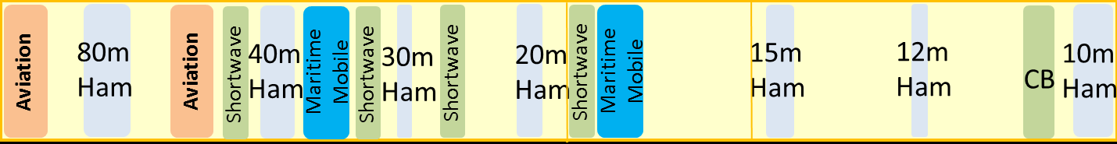
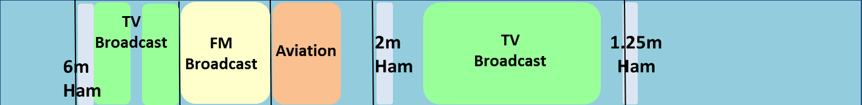
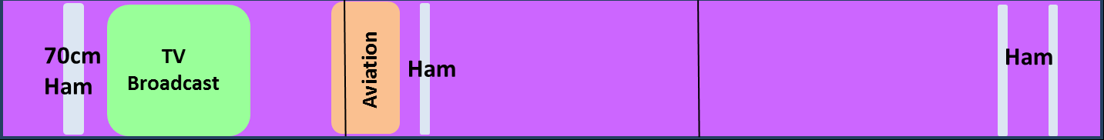
Medium Frequencies (MF) – 300 kHz to 3 MHz
300 kHz
500 kHz
1.64 MHz
1.8 MHz
3 MHz
High Frequencies (HF) – 3 MHz to 30 MHz
3 MHz
10 MHz
15 MHz
20 MHz
30 MHz
Very High Frequencies (VHF) – 30 MHz to 300 MHz
30 MHz
50 MHz
88 MHz
108 MHz
144 MHz
220 MHz
300 MHz
Ultra High Frequencies (UHF) – 300 MHz to 3000 MHz
300 MHz
1000 MHz
2000 MHz
3000 MHz
Chart adapted from WØSTU

Slide 59
K2BSA
Electromagnetic Spectrum
Medium Frequencies (MF) – 300 kHz to 3 MHz
AM Broadcast
160m Ham
300 kHz 500 kHz 1640kHz 1800kHz 3 MHz
High Frequencies (HF) – 3 MHz to 30 MHz
Aviation
80m Ham
Aviation
40m Ham
30m Ham
20m Ham
15m Ham
12m Ham
CB
10m Ham
3 MHz 10 MHz 15 MHz 20 MHz 25 MHz 30 MHz
Very High Frequencies (VHF) – 30 MHz to 300 MHz
6m Ham
TV
FM
Aviation
2m Ham
TV
Ham
30 MHz 88 MHz 108MHz 144 MHz 220 MHz 300 MHz
Ultra High Frequencies (UHF) – 300 MHz to 3000 MHz
Ham
TV
Aviation
Ham
Ham
300 MHz 1000 MHz 2000 MHz 3000 MHz
2013 National Jamboree

Slide 60
Frequency Assignments
K2BSA
Electromagnetic Spectrum
AM Broadcast Radio
FM Broadcast Radio
Short Wave Broadcast
Television Broadcast
CB Radio
Police Radio
Amateur Radio
Mobile Telephone
Wi-Fi
540 - 1600 kHz
88 - 108 MHz
5 - 22 MHz
Channel 2 = 54-60 MHz
27 MHz
450-470 MHz
3.5, 7, 10, 14, 21, 28, 50, 144 MHz
80, 40, 30, 20, 15, 10, 6, 2 meters
850 - 900 MHz, 1800 – 1900 MHz
2400 – 2470 MHz
2013 National Jamboree
Radio M.B Req. 3.a.

Slide 61
How Radio Waves Carry Information
K2BSA
How Radio Waves
Carry Information
A pure radio wave does not convey information.
Radio waves carry information when they are changed by a process called modulation.
Modulation
  Continuous wave (CW)
  Amplitude (AM)
  Frequency (FM)
2013 National Jamboree
Radio M.B Req. 4

Slide 62
K2BSA
How Radio Waves
Carry Information
Radio signals are modulated(changed) with information.
  Morse Code uses dots and dashes
  Voice, images – AM, FM, TV
  Digital modes – 1s and 0s
2013 National Jamboree
Radio M.B Req. 4

Slide 63
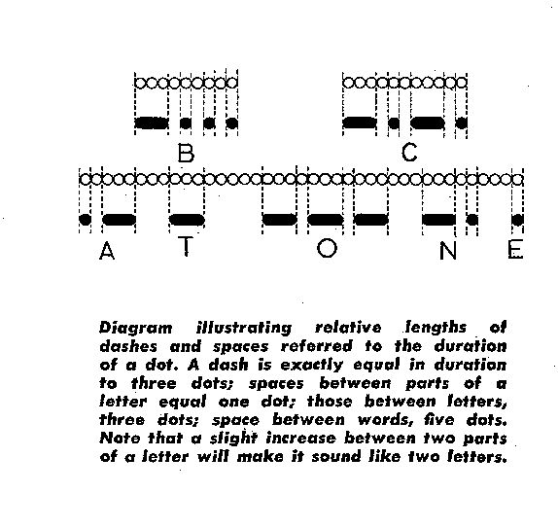
Continuous Wave (CW)
The Oldest Digital Mode
K2BSA
How Radio Waves
Carry Information
Works by simply turning the transmitter
on and off in a pattern called Morse Code
2013 National Jamboree
Radio M.B Req. 4

Slide 64
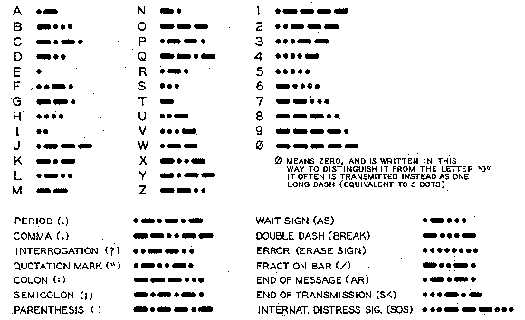
“CW” or Morse Code
K2BSA
How Radio Waves
Carry Information
2013 National Jamboree
Radio M.B Req. 4

Slide 65



Modulation
K2BSA
How Radio Waves
Carry Information
FM
AM
PM
2013 National Jamboree
Radio M.B Req. 4

Slide 66
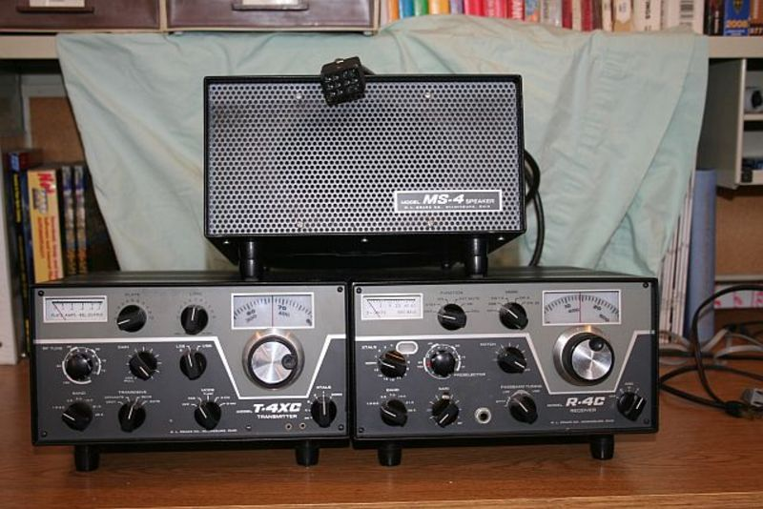
K2BSA
How Radio Waves
Carry Information
Basic Radio Equipment
  A Transmitter sends radio signals using
  modulation to convey information.
  A Receiver converts (demodulates) very weak radio signals into audio.
2013 National Jamboree
Radio M.B Req. 4

Slide 67
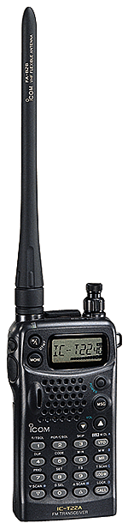
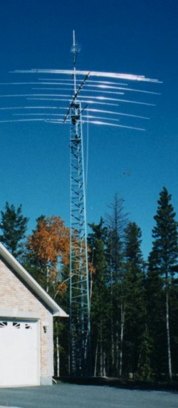
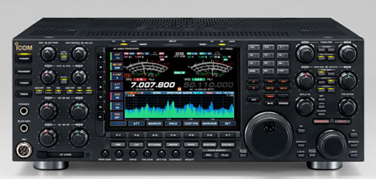
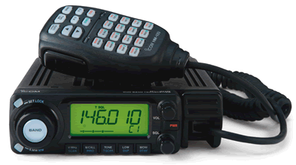
K2BSA
How Radio Waves
Carry Information
Basic Radio Equipment
  A Transceiver combines the transmitter and receiver in one unit.
  An Amplifier increases the strength of the radio wave produced by the transmitter.
  The Antenna sends radio signals out into the air and captures received radio signals.
Transceivers
Antenna
2013 National Jamboree
Radio M.B Req. 4

Slide 68
K2BSA
How Radio Waves
Carry Information
Radio Station Block Diagram
ANTENNA
FEED
LINE
Speaker
RECEIVER
T-R
SWITCH
TRANSMITTER
AMPLIFIER
MIC
KEY
2013 National Jamboree
Radio M.B Req. 4

Slide 69
K2BSA
How Radio Waves
Carry Information
Radio Station Block Diagram
ANTENNA
FEED
LINE
Speaker
TRANSCEIVER
AMPLIFIER
MIC
KEY
2013 National Jamboree
Radio M.B Req. 4

Slide 70

K2BSA
Circuits
Open Circuit
Flashlight
An open circuit exists when the path for electricity is incomplete as when the flashlight switch is off.
Off
On
+
-
National Jamboree
Radio M.B Req. 5c

Slide 71
K2BSA
Circuits
Closed Circuit
Flashlight
A closed circuit exists when the path for electricity is complete as when the flashlight switch is on.
Off
On
+
-
National Jamboree
Radio M.B Req. 5c

Slide 72
K2BSA
Circuits
Short Circuit
Flashlight
A short circuit exists when the path for electricity is completed in an unplanned way like when a tool “shorts” the circuit.
Off
On
+
-
National Jamboree
Radio M.B Req. 5c

Slide 73

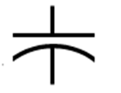


K2BSA
Schematic Symbols
Draw Schematic Symbols
Resistor
Capacitor
Variable Capacitor
Diode
National Jamboree
Radio M.B Req. 5d

Slide 74
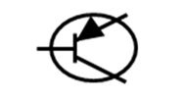


Draw Schematic Diagrams
K2BSA
Schematic Symbols
Transistor
Inductor
Switch
Integrated Circuit
National Jamboree
Radio M.B Req. 5d

Slide 75
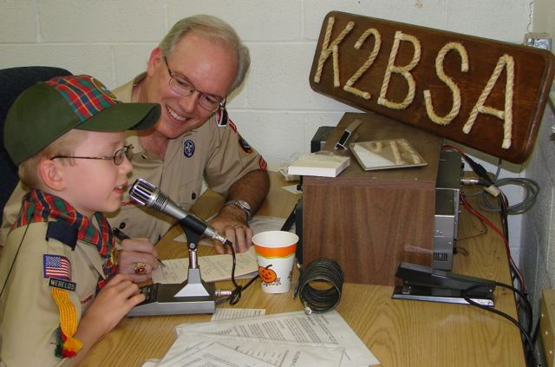
Describe Your K2BSA Visit
K2BSA
Visit K2BSA
What equipment did you see?
How was the equipment used?
What licenses are required to operate and maintain the equipment?
What is the purpose
of the radio station?
2013 National Jamboree
Radio M.B Req. 7

Slide 76
Radio Careers
K2BSA
Radio Careers
Technical Careers
Broadcasting Careers
Operator Careers
2013 National Jamboree
Radio M.B Req. 8

Slide 77
Technical Radio Careers
K2BSA
Radio Careers
A Design Engineer develops the block diagrams and schematics to create a radio.
A Design Technician selects the actual parts and determines the physical arrangement of those parts on the printed circuit board.
A Manufacturing Engineer determines how to purchase the parts and assemble the radio.
A Radio Station Engineer operates and maintains the radio station equipment.
An Electronics Technician repairs radio equipment.
2013 National Jamboree
Radio M.B Req. 8

Slide 78
Broadcasting Careers
K2BSA
Radio Careers
Announcers and Radio/TV Personalities perform the on-the-air communication at a radio or TV station.
The Station Manager is responsible for the overall operation of the radio or TV station.
The Program Director or Music Director will be responsible for the content of the broadcast material.
A Program Writer will be responsible for producing for some programs the actual text read by the Announcers or Personalities.
2013 National Jamboree
Radio M.B Req. 8

Slide 79
Radio Operator Careers
K2BSA
Radio Careers
Radio communication systems are everywhere in our culture.
Many careers include radio operation incidental to the main career role. For example, radio communication is essential for policemen to function effectively.
All public safety functions like fire and ambulance services require radio communication operations.
Aviation traffic management relies on very extensive radio communication networks.
Military operations rely upon radio networks.
2013 National Jamboree
Radio M.B Req. 8

Slide 80
Education for Radio Careers
K2BSA
Radio Careers
Most jobs require high school diploma.
Radio engineers generally study electrical engineering at college.
Colleges offer courses in broadcasting and communications.
Gain broadcasting experience at college radio stations.
Radio technicians attend trade schools or community colleges.
Many organizations offer radio license training courses and certifications.
2013 National Jamboree
Radio M.B Req. 8

Slide 81
Amateur Radio Licenses
K2BSA
Amateur Radio Licenses
Technician Class
  Elementary operating procedures.
  Radio regulations.
  Beginning electronics.
  Emphasis on VHF and UHF.
General Class
  Intermediate practices, regulations, theory.
  Operating privileges in all amateur bands with some limits on frequencies.
  Emphasis on HF.
Amateur Extra Class
  Advanced theory and practices.
  All operating privileges in all bands.
  Administer license exams.
National Jamboree
Radio M.B Req. 9.a.(4)

Slide 82
Technician Class License
K2BSA
Amateur Radio Licenses
No age restriction
Elementary operating procedures
Radio regulations
Beginning electronics
Emphasis on VHF and UHF
35-question, multiple-choice written examination
Minimum passing score is 26 correct answers – 74%
National Jamboree
Radio M.B Req. 9.a.(4)

Slide 83
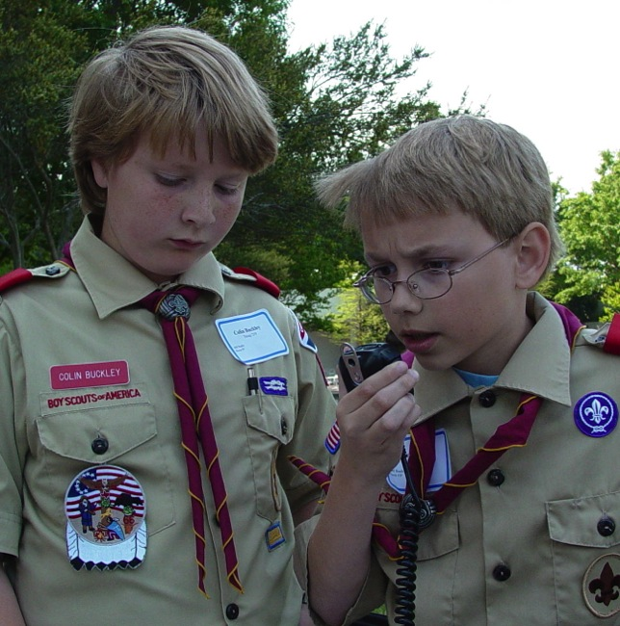
Amateur Radio License Exams
K2BSA
Amateur Radio Licenses
Amateur radio license exams are given by Hams called “Volunteer Examiners”
Exams and free study classes are given by local radio clubs
More information about ham radio can be found at the ARRL web page: www.arrl.org
2013 National Jamboree
Radio M.B Req. 9.a.(4)

Slide 84
Emergency Calls
K2BSA
Emergency Calls
You may use any radio at any time to get help during an emergency.
“Break” “Break” followed by your call sign to interrupt a radio conversation in progress.
“MAYDAY” is the international word for requesting help by radio – “EMERGENCY” also works.
Speak clearly and give a complete location and information like a 911 call.
You might have to climb higher up a hill with an FRS radio or cell phone.
In Morse code you would slowly send SOS
(• • • ─ ─ ─ • • •) and give the same information.
National Jamboree
Radio M.B Req. 9.a.(5)

Slide 85
Radio Station Types
K2BSA
Handhelds, Base, Mobile
Handheld radios (HT): Small, light, portable, but not much power Some can fit in your pocket. With repeaters they can be quite useful and they can easily be carried on a hike.
Base station radios: Permanent station in a building. More power, easier to use, more features.
Mobile radios: Permanent station in a vehicle. More power.
Which kind of radio is best? It depends on what you want to do.
National Jamboree
Radio M.B Req. 9.a.(6)

Slide 86
Repeaters
K2BSA
Handhelds, Base, Mobile
Repeaters are transceivers located on high points (Mountains, tall buildings, satellites) to automatically relay radio signals. Some have connections to the telephone system.
A repeater receive on one frequency and re-transmits on another.
A repeater extends the range of a handheld transceiver.
National Jamboree
Radio M.B Req. 9.a.(6)

Slide 87
VHF Propagation with Repeaters
K2BSA
Handhelds, Base, Mobile
National Jamboree
Radio M.B Req. 9.a.(6)

Slide 88
K2BSA
Radio
Merit Badge
2013 National Jamboree

